Slide 1

EF core
New orm on the block
Notes:
1

Slide 2
How cool EF Core is?
EF Core – what’s that in relations to EF6?
What’s new in model mapping?
How code first migrations works now?
Are queries any faster?
Should I move from EF6 to EF Core?

Slide 3
WHY EF CORE AND NOT EF7?
Cross-platform version of Entity Framework
Written from the scratch (latest version 2.1)
Improved concepts known from EF6
Implemented new features
Emphasis on performance optimization
[Not yet] all features implemented

Slide 4

Model mapping

Slide 5
Model

Slide 6
Model builder
Default schema
Entity type configuration
DB functions
Query types
Key generation: Identity, Sequence, HiLo
Memory-Optimized tables (SQL Server)

Slide 7
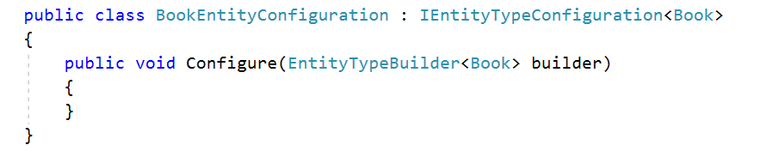
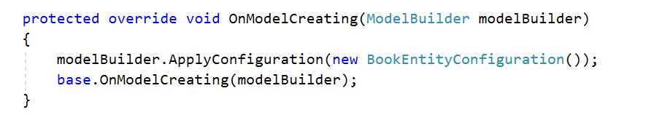
Entity configuration
Implement IEntityTypeConfiguration interface
Use entity configuration class in DBContext

Slide 8
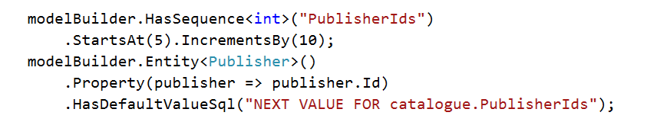
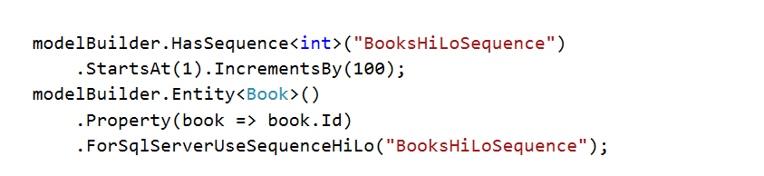
Sequences
SQL Sever Sequence
HiLo Sequence

Slide 9
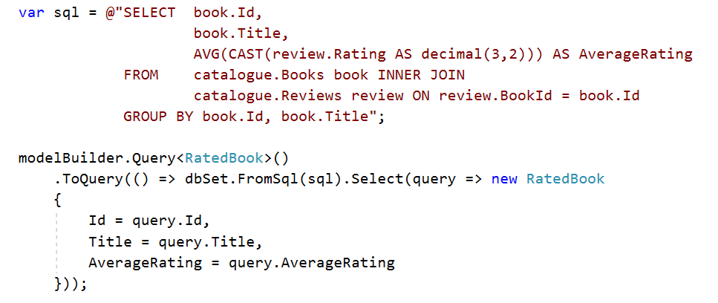
Query types
Raw SQL
View

Slide 10
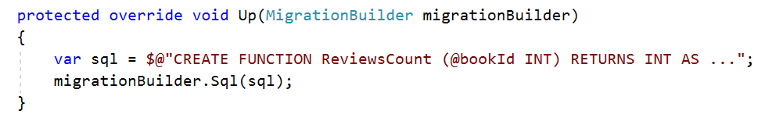
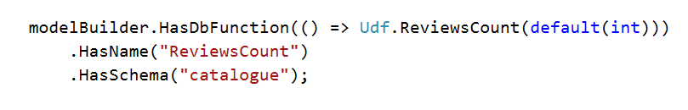
DB FUnctions
Step 1
Step 2
Step 3

Slide 11
Entity MAPPING
Alternate keys
Query filtering
Owned types
Table splitting
Change tracking strategy
Notes:
Alternate keys vs. Unique index
Query filtering - IgnoreQueryFilters

Slide 12
Entity KEys
Primary key
Alternate key
Unique index

Slide 13
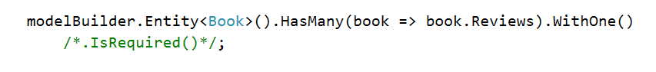
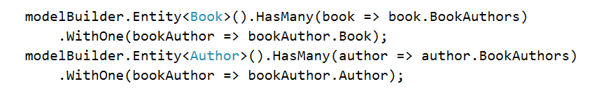
relationships
One-to-many
Many-to-one
Many-to-many (with join entity ☹)

Slide 14
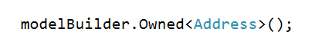
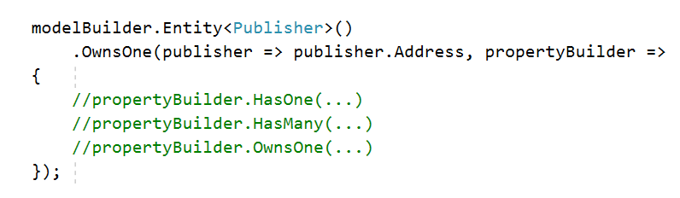
Owned types
Global mapping
Entity mapping

Slide 15
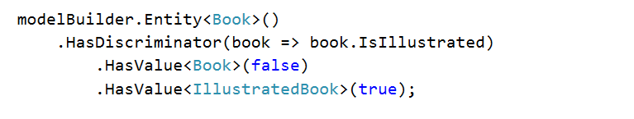
Inheritance – tph only
Define discriminator
Define base class

Slide 16

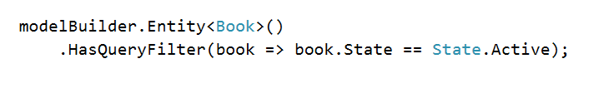
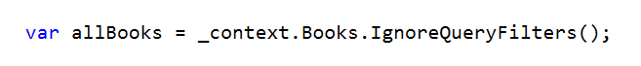
Query filtering
Map
Ignore

Slide 17
Table splitting

Slide 18
PROperty mapping
Computed columns
Default values
Property conversion
Property generators
Use fields instead of properties
Shadow state properties
Concurrency: IsConcurrencyToken vs IsRowVersion

Slide 19
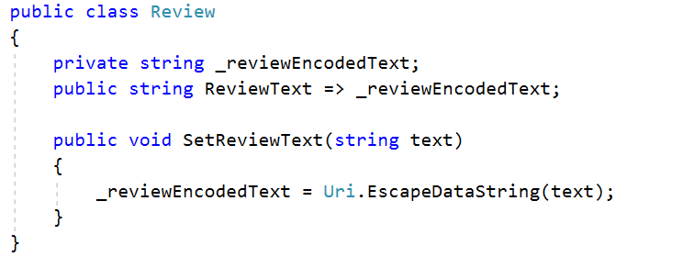
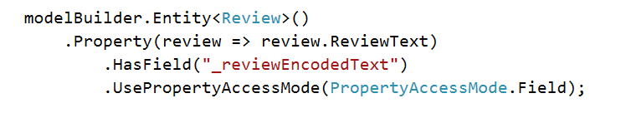
Field Mapping
Field in entity class
Field mapping

Slide 20
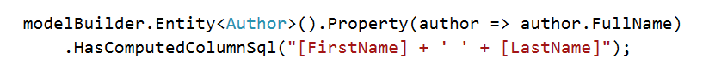
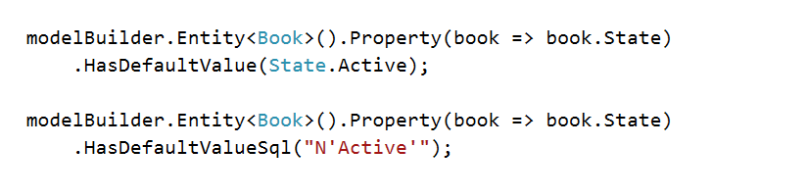
DB Generated values
Computed columns
Default values

Slide 21
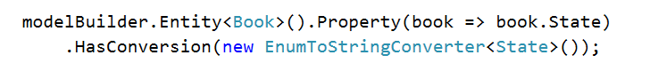
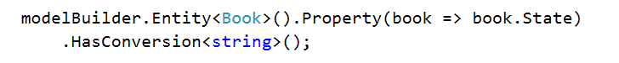
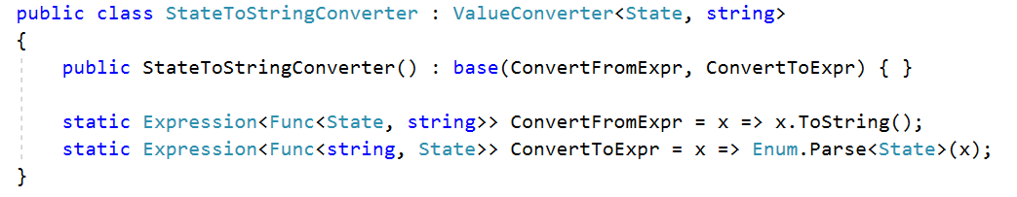
Property conversion
Explicit conversion
Implicit conversion
Custom converter

Slide 22
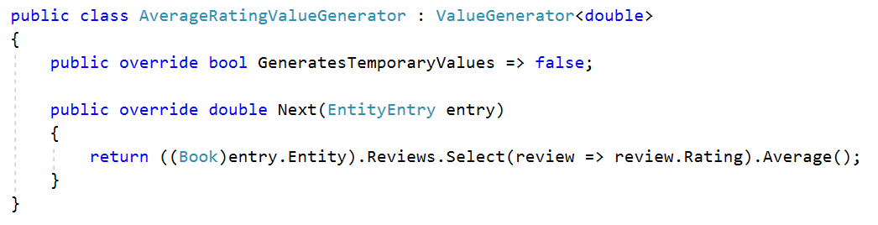
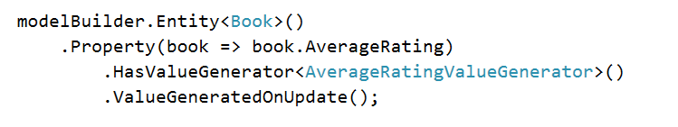
Value generation
Define value generator
Mapping

Slide 23
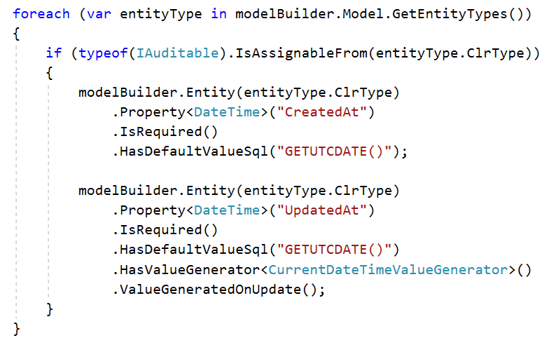
Shadow properties

Slide 24
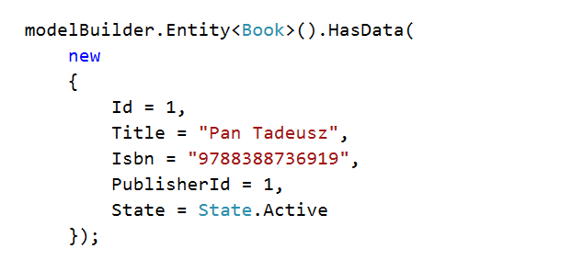
Data SEEDING
Defined as a part of entity mapping
Anonymous objects can be used
Generated as part of migrations

Slide 25

Code first Migrations

Slide 26
CODE FIRST migrations – NEW STUFF
Support for both PS functions and dotnet CLI commands
Possibility of creating a separate project for migrations
Possibility of changing migrations history table structure

Slide 27
CODE FIRST migrations in ef core
ModelSnapshot class generated with the first migration
Migration generated as:
[fileName].cs - migration class with Up and Down methods,
[fileName].Designer.cs - migration metadata file
Migration history - stored in __EFMigrationsHistory table without any model state
Removing migration with remove-migration command!

Slide 28
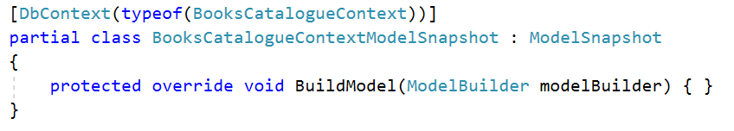
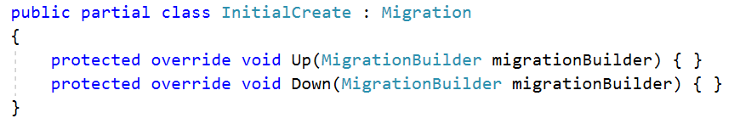
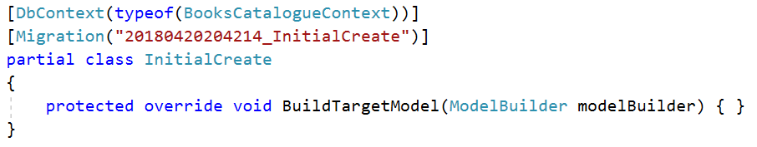
Code first migrations
Model snapshot
Migration file
Designer

Slide 29
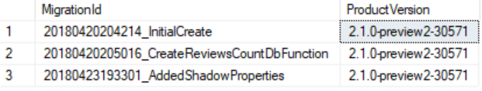
Code first migrations
Migrations history - stored in __EFMigrationsHistory table
Migrations should be removed explicitly with Remove-Migration command

Slide 30

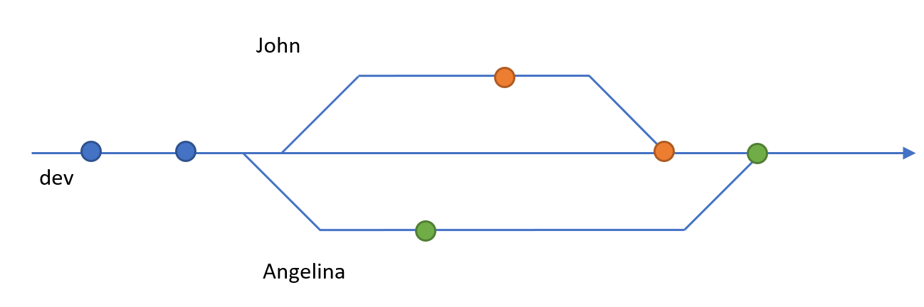
PROBLEM: migrations in team environments

Slide 31

Queries

Slide 32
Client vs server query evaluation

Slide 33
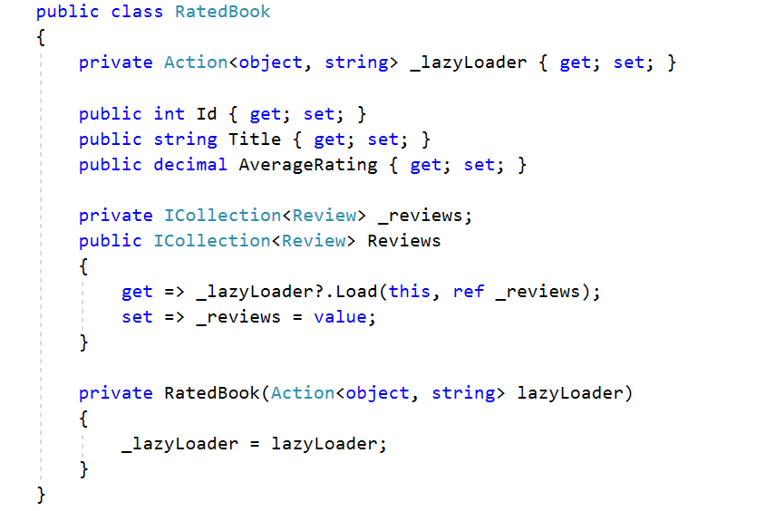
Loading Related data – lazy loading

Slide 34
Loading Related data – EAGER loading

Slide 35
Projections!

Slide 36
TRACKING vs no-tracking

Slide 37
SPeed

Slide 38

Ladder Infographics for PowerPoint
Should I move from EF 6 to ef core?

Slide 39
What’s missing HERE?
Many-to-many without join entity
Inheritance: Table per hierarchy (TPH) only
Mapping to stored procedures
Spatial data
Entity splitting

Slide 40
Ladder Infographics for PowerPoint
Thank you! ☺
e-mail: ags@kmd.dk

